Slide 1
Building Resilience & Responding to Anxiety: An evening of Positive Behaviour Tips & Techniques
Pegasus Bay School– 6th August, 2019

Slide 2
The Ideal Child....
Compliant
Positive
Risk-taker
Hard-working
Sense of humour
Happy
Engaged
Able to focus
Learns from mistakes
Can solve their own problems
Can admit their mistakes

Slide 3
What are the causes of behaviour: The WHY...
A. To get something
I yell because I get attention
I cry to get my parents to focus on me
I overly dramatise to get my parents reaction
B. To avoid something
I cry when something gets hard because someone will help me
I throw a tantrum so I won’t have to pick up my toys

Slide 4
The science of behaviour has taught us that we…
are not born with ‘bad behaviours’
do not learn when presented with unpleasant consequences alone
do learn better ways of behaving by being taught directly and receiving positive feedback.
Develop resilience through solving problems (ON MY OWN) and being allowed to fail.

Slide 5
You cannot change someone else’s behaviour – they must choose to change.
You can only change the way you react to that behaviour.
Your reaction will determine whether they choose to change their behaviour.
Your reaction can enable or disable your child’s acquisition of problem-solving skills

Slide 6
What tools do I have?
My reaction
My maturity
My reaction
My developed (we hope) frontal cortex
My reaction
My modelling
MY REACTION

Slide 7
Some possible approaches I’ve seen....

Slide 8
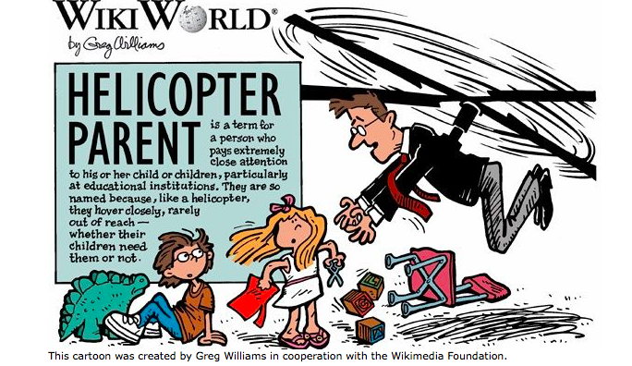
Helicopter Parents...

Slide 9
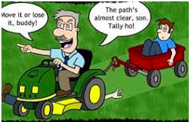
The Lawnmower Parent...

Slide 10
I’m a parent and I get it....
Some of the ways we judge ourselves and feel judged by others as parents....
How many positive experiences does my child get?
Does my child cry or get upset during the day?
Does my child do as many activities as their peers?
Does my child experience disappointment?
Has my child received a negative consequence?
Was my child treated fairly (based on their story)?
Were they believed?

Slide 11
What are the possible flow-on impacts from such approaches?
I’ve seen kids who...
Go from happy and settled at 2:55 to hysterical and in tears when mum arrives...
Who never settle at pre-school because a parent is (themselves) unable to leave their child.
Who create stories about their day that simply didn’t happen.
Are unable to accept ANY responsibility for their actions.
Become overly dependent on others to solve their problems/challenges

Slide 12
Short-Term Pain vs. Long-Term Gain
When we try to appease/pacify/solve problems for our children.....what is our goal?
What is the message we are sending them?
What is the world we are preparing them to live in and that they will be entering in a few short years?

Slide 13
So what do we do to build resilience and reduce anxiety?!?!?!
Don’t panic
What follow are some ideas / suggestions...

Slide 14
It’s not FAIR!!!!!!!
How about teaching our children the difference between equality and equity....

Slide 15
Equality Equity

Slide 16
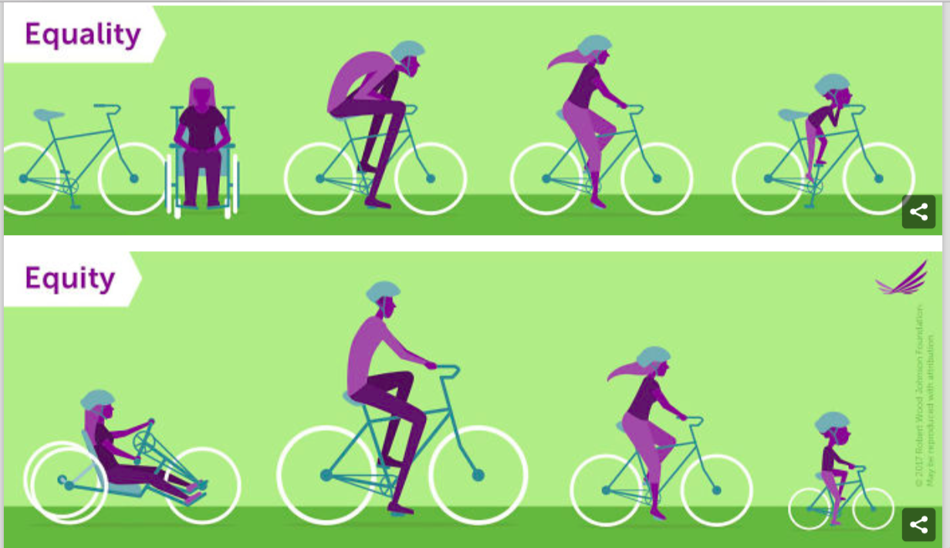
Giving children choices is very empowering
We choose the choices
Then....we don’t care which choice they choose
Can spend the whole day simply giving options
Works all the way up through and including teenagers.

Slide 17
It’s not FAIR!!!!!!!
That’s true – so what are YOU going to do about it?
Shift the focus from out of our control to within our control...

Slide 18
Saying no...
Our job as ADULTS is to establish and maintain boundaries
Sometimes its HOW you give the message
It does get easier...

Slide 19
Saying NO / Disappointment
What’s the future prognosis if we struggle to do this?
Have to experience failure in order to understand success
“Inoculating for future failures...”

Slide 20
Disappointment – making it work
How and when do we expect children to learn how to recover / bounce back (resilience) from disappointment if they don’t practice it?
Talk about what can be learned – or what needs to happen the next time in order to experience success.

Slide 21
Develop and reinforce expectations with logical consequences
I think of it as a simple three-step model...
Step 1: Develop and make explicit your expectations in all settings and at all times...

Slide 22
Don’t Just
Tell Them
What Not
To Do…
…Teach Them
What You
Want Them To Do Instead!
22
Notes:
22
Make the rules
Relevant
Positive
Measureable

Slide 23
Develop and reinforce expectations with logical consequences
I think of it as a simple three-step model...
Step 1: Develop and make explicit your expectations in all settings and at all times...
Step 2: Let your children know what happens when they get it right...

Slide 24
When they get it right.....
Use When....Then....
This is a great default strategy
Works to develop childrens’ ownership of their behaviours
Rewards –or- bribes?

Slide 25
When they get it right.....continued...
CHOICE THEORY
Giving children choices is very empowering
We choose the choices
Then....we don’t care which choice they choose
Can spend the whole day simply giving options
Works all the way up through and including teenagers.

Slide 26
Develop and reinforce expectations with logical consequences
I think of it as a simple three-step model...
Step 1: Develop and make explicit your expectations in all settings and at all times...
Step 2: Let your children know what happens when they get it right...
Step 3: Let your children know what happens when they get it wrong...

Slide 27
Useful Consequences
Reduce the likelihood of a behaviour ocurring in the future – and don’t have to be decided in the moment
Are designed to manage behaviour not necessarily eliminate
Remember to keep them:
Short in duration
Related to the behaviour
Deliberate and NOT reactive
Spare and up your sleeve

Slide 28
Timeouts: making them work
Super Nanny – 1 minute per year of age
Timeout DOESN’T START UNTIL they are in the correct spot and doing the correct thing
If they move, act out, etc...reset the timer
As soon as it dings, check in and ask the BIG 3
What went wrong for you?
What could you have done instead?
What will you do now?
If they can’t answer – start the cycle again

Slide 29
The “Muck Up, Own Up” model...
One way to think about the process is to use the following model....
Muck UP
Own Up
Fix Up
Move ON

Slide 30
What about those BIG emotions?
Don’t get sucked in
Be the adult
Respond calmly and quietly
When all else fails....wait

Slide 31
Be the Grown-up....
My kids are so irrational....
They always argue, why can’t they give in?
Punishment is how I get even
Don’t get sucked in...
Actually instead –
Role Model
Be the behaviour you want to see
Think about “The Ideal Child”

Slide 32
Good, Bad & Interesting News
Good News: You can absolutely change the behaviour of your child
Bad News: You will have to change and manage the way you react to your child’s behaviour
Interesting News: For every year a behaviour has been in place, expect 1 month of consistent, well-planned behavioural intervention before change will occur

Slide 34
The Ideal Child....
Compliant
Positive
Risk-taker
Hard-working
Sense of humour
Happy
Engaged
Able to focus
Learns from mistakes
Can solve their own problems
Can admit their mistakes

Slide 35
The Ideal Parent....
Compliant
Positive
Risk-taker
Hard-working
Sense of humour
Happy
Engaged
Able to focus
Learns from mistakes
Can solve their own problems
Can admit their mistakes

Slide 36
Tim Heidmann Member NZAC , Master of Education (Dist), Master of Specialist Teaching, Graduate Diploma Teaching & Learning, Bachelor of Science

